Slide 1
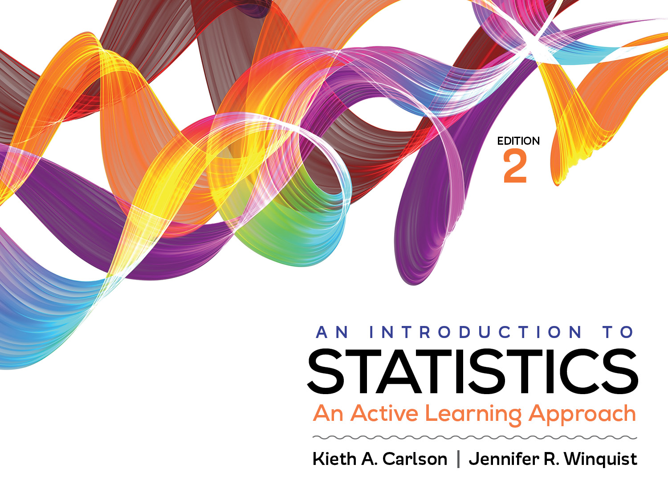
Introduction to Activity 6.3
Statistical Power, Type I Error, and Type II Error

Slide 2
Activity 6.3 will require you to:
Use the null and research distribution of sample means to describe statistical power, Type I error, and Type II error.
Understand how each of the above concepts is effected by the:
effect size of the treatment
Sample size of the study
Alpha value
Variability in a sample

Slide 3
Null and research distribution of sample means
Null curve
Size of treatment effect determines location of Research curve;
Larger effects move curve more further right
Studies with small treatment effects (i.e., effect sizes) have low statistical power and a higher chance of Type II Error
Type I Error
Research curve
Type II Error
Statistical Power
-3 -2 -1 0 1 2 3 4 5
Notes:
Changing the size of the treatment effect changes the location of the research curve. The critical value line stays were it is “anchored” at 1.65 but the research curve slides to the right for bigger treatment effects and slides to the left for smaller treatment effects. Have students notice the impact this has of type II error and statistical power. Note the size of the treatment effect has no effect on the critical region.

Slide 4
Null and research distribution of sample means
Size of treatment effect determines location of Research curve;
Larger effects move curve more further right
Increasing treatment effect increases statistical power and decreases Type II error
Null curve
Type I Error
Research curve
Type II Error
Statistical Power
z score
-3 -2 -1 0 1 2 3 4 5
Notes:
Changing the size of the treatment effect changes the location of the research curve. The critical value line stays were it is “anchored” at 1.65 but the research curve slides to the right for bigger treatment effects and slides to the left for smaller treatment effects. Have students notice the impact this has of type II error and statistical power. Note the size of the treatment effect has no effect on the critical region.

Slide 5
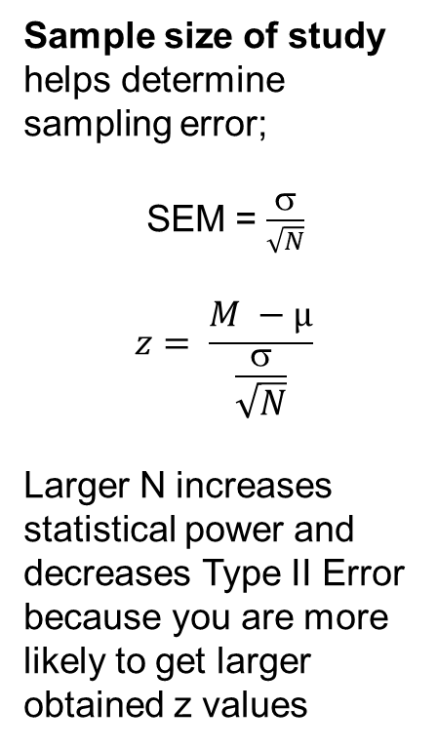
Null and research distribution of sample means
Sample size of study helps determine sampling error;
SEM = $\frac{σ}{\sqrt{N}}$
$$z= \frac{M −µ}{\frac{σ}{\sqrt{N}}}$$
Larger N increases statistical power and decreases Type II Error because you are more likely to get larger obtained z values
Null curve
Type I Error
z score
Research curve
Type II Error
Statistical Power
-3 -2 -1 0 1 2 3 4 5
Notes:
The effect of changing N is difficult to show on static curves. Larger N decreases sampling error which generally makes your study more accurate (i.e., more power) and less type II error.

Slide 6
Null and research distribution of sample means
Alpha value determines size of critical region;
Larger alpha/critical region means more statistical power (less Type II error rate) but also larger Type I error rate.
This figure represents an alpha of .05. If the alpha were .01 the vertical line would be moved right. What impact would that have on Type I error, Type II error and statistical power?
Null curve
Type I Error
Research curve
Type II Error
Statistical Power
-3 -2 -1 0 1 2 3 4 5
Notes:
Changing alpha from .05 to .01 means that the critical region line (critical value) moves to the right (it gets smaller). This is difficult for many students to recognize. The want to move it to the left; be ready to explain why moving it to the right is correct. [alpha = the size of the critical region; moving from .05 to .01 means the critical region has to get smaller which means moving critical value to the right.]

Slide 7
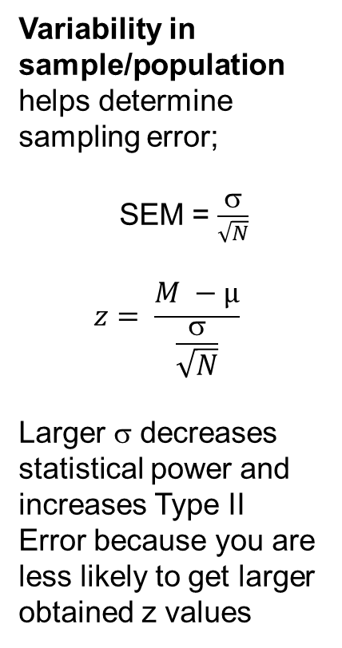
Null and research distribution of sample means
Variability in sample/population helps determine sampling error;
SEM = $\frac{σ}{\sqrt{N}}$
$$z= \frac{M −µ}{\frac{σ}{\sqrt{N}}}$$
Larger σ decreases statistical power and increases Type II Error because you are less likely to get larger obtained z values
Null curve
Type I Error
Research curve
Type II Error
Statistical Power
-3 -2 -1 0 1 2 3 4 5
Notes:
Changing the variability changes the scales of both curves. It is difficult to show the effect this has on each of these statistical concepts on static curves. Increasing variability reduces statistical power when the null is false.

Slide 8
Helpful hints
Make sure you understand how changing the various values changes the graphs in this computer applet.
Understanding how these concepts effect each other will really help you later in the course.

